Slide 1



Introduction to AI and Data Science
Attendance
linktr.ee/CODE.CRUNCH

Slide 2
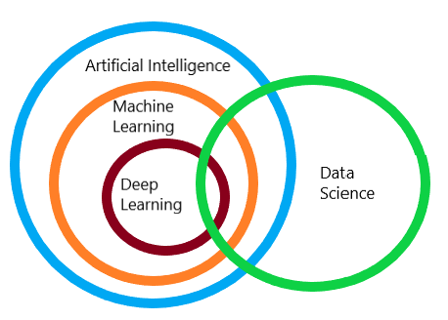
Introduction to AI and Data Science
What is Data Science:
Data Science is the field that uses statistical and computational techniques to analyze data and derive insights or predictions.
What is Artificial Intelligence:
Artificial Intelligence (AI) is the simulation of human intelligence by machines.
enabling them to perform tasks like learning, reasoning, and problem-solving.
What is Machine Learning:
Machine Learning is a subset of AI that enables systems to learn from data and improve their performance on tasks without being explicitly programmed.

Slide 3
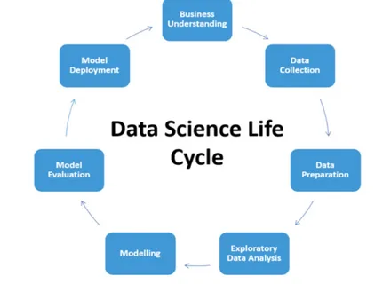
Components of Data Science
Data Collection:
Gathering data from various sources like databases, sensors, web scraping, APIs, or surveys.
Data Processing and Cleaning:
Ensuring data quality by handling missing values, outliers, and inconsistencies.
Techniques include:
normalization
standardization
imputation.
Exploratory Data analysis:
Using statistical and visualization tools (e.g., histograms, scatter plots) to uncover patterns, correlations, and trends in the data.

Slide 4
cont.
Modeling:
Using algorithms (e.g., regression, decision trees, neural networks) to create models that predict outcomes or classify data.
Interpretation:
Presenting insights through dashboards, graphs, and charts using tools like Matplotlib, Seaborn, Tableau, or Power BI.
Deployment:
Implementing models in real-world applications (e.g., recommendation systems, fraud detection).

Slide 5
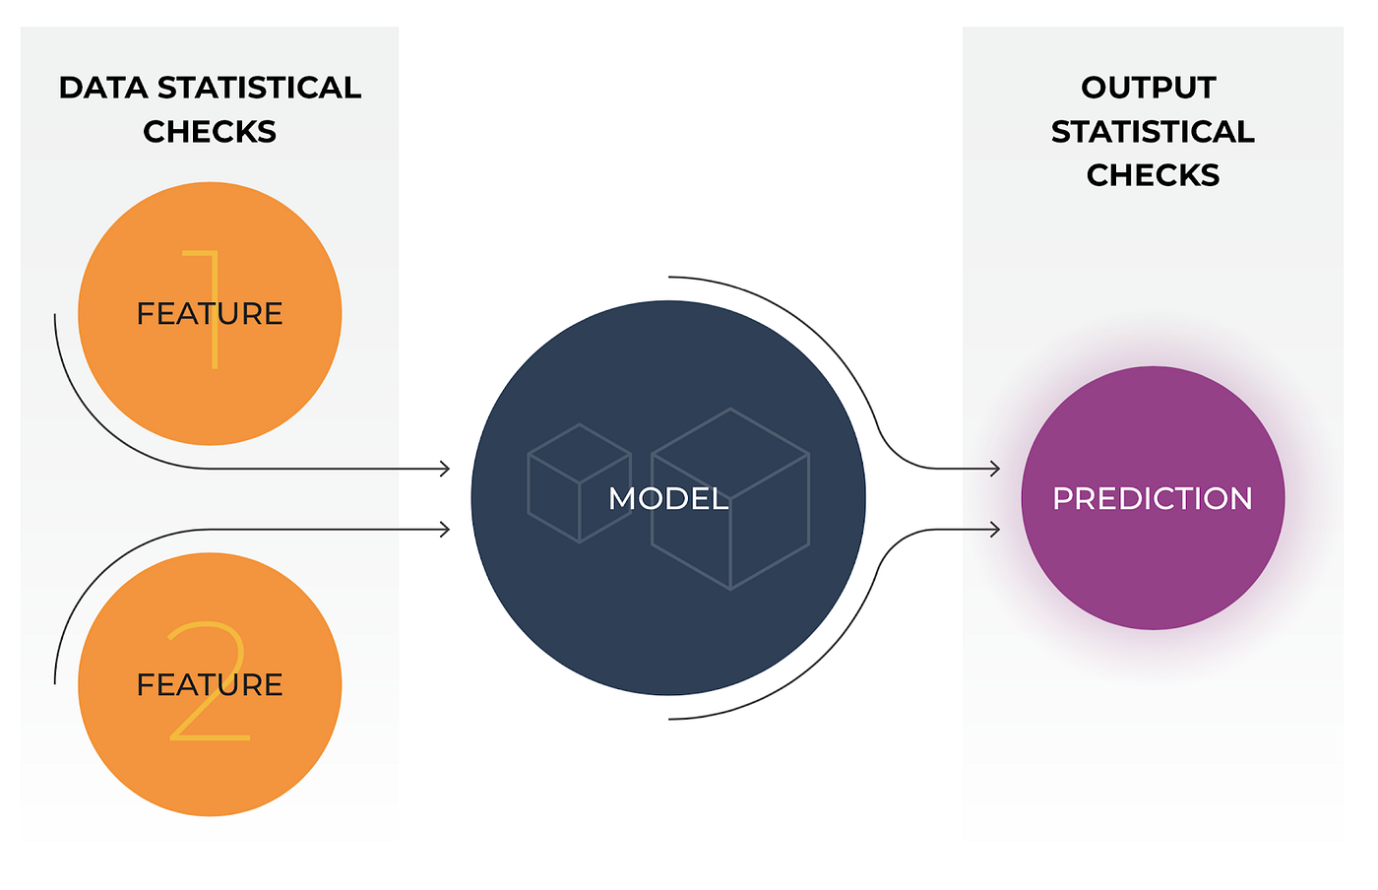
Machine Learning
focuses on developing algorithms and models that allow computers to learn from and make predictions or decisions based on data.
model - a mathematical function for describing the relationship between input and outputs for making predictions
algorithm - a procedure or set of decision rules used to carry out a task or prediction

Slide 6
Q&A Session

Slide 7





Attendance
Join us for the next sessions
Thursdays: 11AM – 12PM & 2PM – 3PM
Friday: 3PM – 4PM
Monday: 12PM – 1PM
RSVP lu.ma/CODECRUNCH
Your feedback helps us improve. Share your thoughts! Go to our website: go.fiu.edu/codecrunch
linktr.ee/CODE.CRUNCH

